Slide 1
Council Roadside Reserves Project
Guidelines to Prepare a Review of Environmental Factors
Prepared on behalf of LGNSW for the Council Roadside Reserves Project

Slide 2
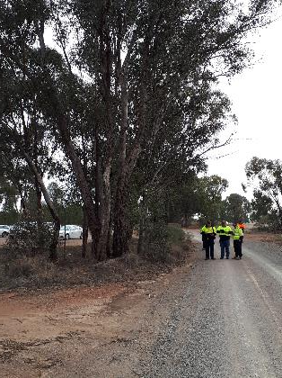
Introduction
Councils have a statutory responsibility under the NSW Environmental Planning and Assessment Act 1979 (EP&A Act) to consider the impacts of their activities, including road construction and maintenance works, on the environment.
Council Roadside Reserves Project

Slide 3
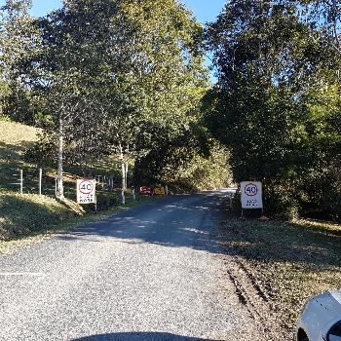
Introduction
These slides are designed to guide councils in undertaking an environmental assessment of the potential impacts of their activities on the environment.
Topics:
Relevant legislation
Methodologies for database searches and assessment;
Completing a Review of Environmental Factors
(REF) using the template provided
Council Roadside Reserves Project

Slide 4
When is a Review of Environmental Factors (REF) required?
Guided by legislation:
EP&A Act
Part 4
Division 5.2
Division 5.1
Exempt
No planning/
construction
approval required
Complying
Fast-track approval
process
Local Development permitted with consent (Local Council)
Regional Development permitted with consent (Planning Panel)
State Significant Development (SSD)
Development without consent: Part 5 approvals for public authorities
Standards within State Environmental Planning Policy
(Exempt and Complying Development Codes ) 2008
Environmental Assessment required as part of a DA:
Statement of Environmental Effects;
Environmental Impact Assessment
Environmental Impact Statement (EIS)
Review of Environmental Factors (REF)
Next slide
Council Roadside Reserves Project

Slide 5
When is a Review of Environmental Factors (REF) required?
Activity to be assessed under Part 5 of EP&A Act
‘Activity’ is defined in the EP&A Act as:
the use of land;
the subdivision of land;
the erection of a building;
the carrying out of a work;
the demolition of a building or work.
‘Proponent’ is defined as the person proposing to carry out the activity
‘Determining Authority’ means the Minister or public authority whose approval is required in order for the activity to be carried out.
Yes
Is the proposal an ‘activity’?
Yes
Is Council both the ‘proponent’ and the ‘determining authority’
Yes
Next slide
Council Roadside Reserves Project

Slide 6
When is a Review of Environmental Factors (REF) required?
Proposed Activity in ‘Road Maintenance Zone’
Yes
Exempt Development:
No assessment required
No
‘Major Works’
Yes
REF Required:
Major Works REF Template
No
REF Templates have been prepared as part of this project
‘Minor Works’
Yes
REF Required:
Minor Works REF Template
REF Required:
Routine Works REF Template
Shoulder Grading
Slashing
etc
‘Routine Maintenance’
Council Roadside Reserves Project

Slide 7
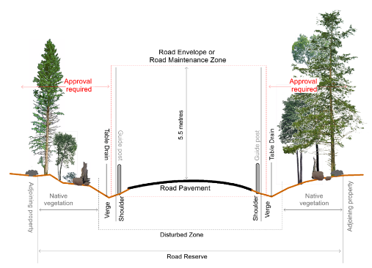
Road Maintenance Zone
Austroads defines the Road Maintenance Zone (RMZ) as:
1m either side of a sealed road
Up to 5.5m above ground
Routine maintenance works are permissible within the RMZ without approval.
Outside this area you will need to assess the potential impacts.
Council Roadside Reserves Project

Slide 8
What is an ‘REF’?
The type of environmental impact assessment required under Division 5.1 of the EP&A Act.
Examines the potential environmental impacts of a proposed activity.
Factors that must be assessed are defined in s228 of the Environmental Planning and Assessment Regulation 2000.
Risk-based assessment which considers:
The location and existing environmental factors of the proposed activity;
The potential impacts for the proposed activity on those environmental factors;
Potential for successful impact mitigation;
Community and stakeholder expectations.
Council Roadside Reserves Project

Slide 9
Preparing an REF
Resources:
‘REF Methodology’ Excel Workbook to guide Council staff through preparing an REF for roadside projects;
includes links to data sources and lookup tables.
‘Approval Pathway’ fact sheet to assist Council staff to decide when an REF is required;
REF templates for different types/scale of activities:
Major Works
Minor Works
Routine activities
Council Roadside Reserves Project

Slide 10
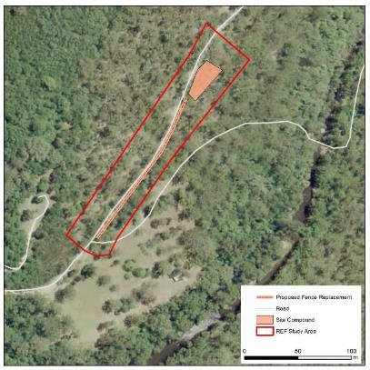
Preparing an REF
Step 1: Define the subject site/ study area for the REF:
Site of the proposed activity;
Consider need for access to site, site compounds etc;
Consider allowing for a ‘buffer’ to assess all potential impacts.
Example: REF Study Area includes proposed fence replacement alongside the road, as well as site compound area and buffer.
Council Roadside Reserves Project

Slide 11
Preparing an REF
Step 2: Data Audit
REF Content | Data Required for REF | Data Source (if not available on Council’s GIS)
Location | Lot and DP / Address/ Coordinates | SIX Maps: https://maps.six.nsw.gov.au/
Site Context | Site and surrounds | NSW Imagery WMS: https://www.spatial.nsw.gov.au/products_and_services/web_services/access_web_services
Topography | Topography | SIX Topographic Data: https://maps.six.nsw.gov.au/clipnship.html
Hydrology | Drainage/ hydrology/ catchment | SIX Hydrology Data: https://maps.six.nsw.gov.au/clipnship.html
 | Flood prone land | LEP Flood Prone Land: https://geo.seed.nsw.gov.au/Public_Viewer/index.html?viewer=Public_Viewer&locale=en-AU&runWorkflow=AppendLayerCatalog&CatalogLayer=SEED_Catalog.148.Flood
Land use and ownership | Land ownership | Council’s property database
 | Proximity to NPWS Land | SEED Webmap: https://geo.seed.nsw.gov.au/Public_Viewer/index.html?viewer=Public_Viewer&locale=en-AU&runWorkflow=AppendLayerCatalog&CatalogLayer=SEED_Catalog.73.NPWS%20Estate
Council Roadside Reserves Project

Slide 12
Preparing an REF
Step 2: Data Audit
REF Content | Data Required for REF | Data Source
SEPP | SEPP (Coastal Management) 2018 | SEED Webmap: https://geo.seed.nsw.gov.au/Public_Viewer/index.html?viewer=Public_Viewer&locale=en-AU&runWorkflow=AppendLayerCatalog&CatalogLayer=SEED_Catalog.134.Land%20Application%20Map
Soil Types | Soil types | SEED Webmap: https://geo.seed.nsw.gov.au/Public_Viewer/index.html?viewer=Public_Viewer&locale=en-AU&runWorkflow=AppendLayerCatalog&CatalogLayer=SEED_Catalog.108
 | Soil salinity | SEED Webmap: https://geo.seed.nsw.gov.au/Public_Viewer/index.html?viewer=Public_Viewer&locale=en-AU&runWorkflow=AppendLayerCatalog&CatalogLayer=SEED_Catalog.148.Salinity
Contaminated Land | Contaminated sites | EPA Public Register – Contaminated Sites https://datasets.seed.nsw.gov.au/dataset/contaminated-land-list-of-nsw-contaminated-sites-notified-to-epa
Acid Sulfate Soils | Potential Acid Sulfate Soils maps | SEED Webmap: https://geo.seed.nsw.gov.au/Public_Viewer/index.html?viewer=Public_Viewer&locale=en-AU&runWorkflow=AppendLayerCatalog&CatalogLayer=SEED_Catalog.106
Council Roadside Reserves Project

Slide 13
Preparing an REF
Step 2: Data Audit
REF Content | Data Required for REF | Data Source
Biodiversity | Vegetation Communities and EECs | SVTM/ VIS Mapping on SEED
 | Threatened Fauna records within 10km | NSW Bionet Atlas: 10km search EPBC Protected Matters Search: 10km search
 | Threatened Flora records within 10km | NSW Bionet Atlas: 10km search EPBC Protected Matters Search: 10km search
Aboriginal heritage | Items of Aboriginal heritage significance | AHIMS Database: Basic Search
Non-Aboriginal heritage | Items of Non-Aboriginal heritage significance | State Heritage Register: https://www.environment.nsw.gov.au/heritageapp/heritagesearch.aspx LEP Heritage: https://geo.seed.nsw.gov.au/Public_Viewer/index.html?viewer=Public_Viewer&locale=en-AU&runWorkflow=AppendLayerCatalog&CatalogLayer=SEED_Catalog.147.Heritage
Council Roadside Reserves Project

Slide 14
Database searches explained
NSW Bionet Atlas https://www.environment.nsw.gov.au/atlaspublicapp/UI_Modules/ATLAS_/AtlasSearch.aspx
EPBC Protected Matters: https://www.environment.gov.au/epbc/protected-matters-search-tool
SVTM/VIS Mapping: https://www.environment.nsw.gov.au/vegetation/state-vegetation-type-map.htm
AHIMS Search https://www.environment.nsw.gov.au/awssapp/login.aspx
Council Roadside Reserves Project

Slide 15
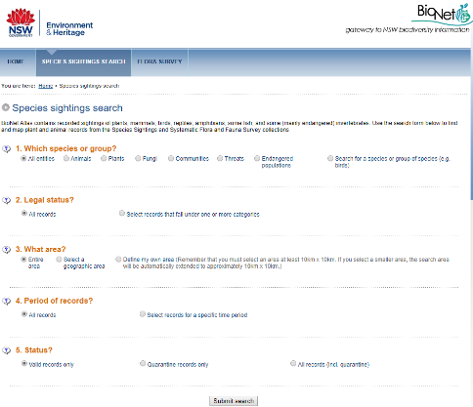
NSW Bionet Atlas
Search area: minimum 10km radius of site;
Download records;
Council Roadside Reserves Project

Slide 16
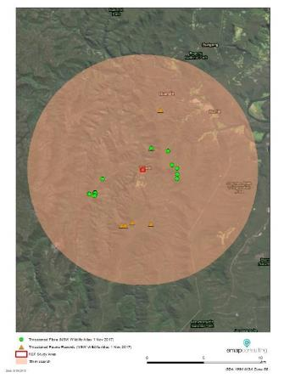
NSW Bionet Atlas
Add records from Bionet Excel spreadsheet as ‘xy’ data to GIS;
Select records within 10km buffer of REF site/study area;
Export data tables to Excel spreadsheet (see next slide).
Council Roadside Reserves Project

Slide 17
NSW Bionet Atlas
The “REF Methodology” Excel workbook has been created to assist you with this.
Paste the threatened flora records into the first 4 columns of the ‘Threatened Flora’ tab
Paste the threatened fauna records into the first 4 columns of the ‘Threatened Fauna’ tab
Paste any threatened ecological communities records into the first 4 columns of the ‘TECs’ tab
Council Roadside Reserves Project

Slide 18
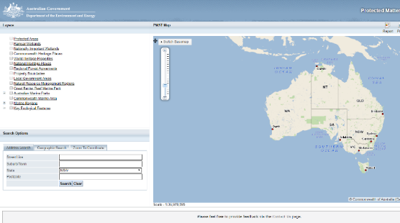
EPBC Protected Matters Search Tool
Search by address, coordinates or using map interface.
Search area: minimum 10km radius of site;
Report is sent as PDF Report to your email address.
Manually add records from the EPBC Protected Matters PDF report to the relevant tabs in Threatened Species tabs in the REF Methodology workbook.
Council Roadside Reserves Project

Slide 19
Vegetation Data Sources
SEED: NSW Bionet Vegetation Classification Data Collection https://datasets.seed.nsw.gov.au/dataset/nsw-bionet-vegetation-classification-data-collectiond2a04
NSW vegetation community typology including PCTs.
State Vegetation Type Mapping (SVTM) https://www.environment.nsw.gov.au/vegetation/state-vegetation-type-map.htm
Regional Scale mapping of PCTs
Bionet Vegetation Classification https://www.environment.nsw.gov.au/NSWVCA20PRapp/LoginPR.aspx
Public access database and vegetation community lookup tables;
PCT and TEC correlations
Note: The REF Methodology Workbook contains lookup tables to the relevant vegetation map for your LGA
Council Roadside Reserves Project

Slide 20
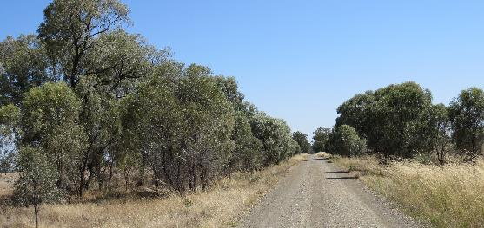
TECs
Data sources for Threatened Ecological Communities:
Vegetation mapping;
Bionet Atlas for Vegetation Classification;
EPBC Protected Matters Search Report
Council Roadside Reserves Project

Slide 21
Aboriginal Heritage
Due Diligence Code of Practice for Protection of Aboriginal Objects in NSW;
The National Parks and Wildlife Regulation 2009 (the Regulation), under Clause 80B describes defences of carrying out certain low impact activities:
(1) It is a defence to a prosecution for an offence under section 86(2) of the Act, if the defendant establishes that the act or omission concerned:
was maintenance work of the following kind on land that has been disturbed: (i) maintenance of existing roads, fire and other trails and tracks, (ii) maintenance of existing utilities and other similar services (such as above or below ground electrical infrastructure, water or sewage pipelines).
(2) For the purpose of this clause, land is disturbed if it has been the subject of human activity that has changed the land surface, being changes that remain clear and observable.
Council Roadside Reserves Project

Slide 22
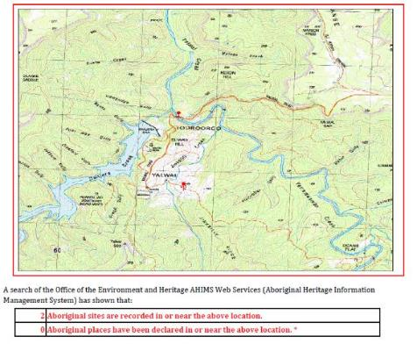
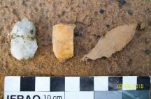
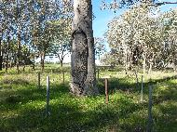
AHIMS Search
Roadside works classified as ‘low impact activity’;
Basic search to identify sites for due diligence purposes;
Report is created as PDF Report to download.
Council Roadside Reserves Project

Slide 23
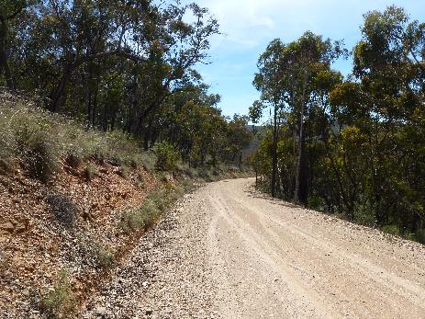
Preparing an REF
Step 3: Consider Existing Environment & Impact Assessment
Landform, Geology and Soils
Consider soil types and slope, salinity risk
Disturbance due to proposed activity?
Potential risk of soil erosion?
Council Roadside Reserves Project

Slide 24
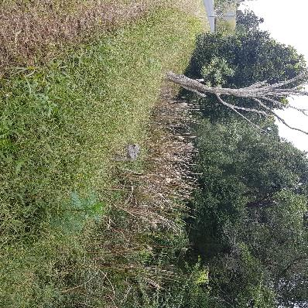
Preparing an REF
Step 3: Consider Existing Environment & Impact Assessment
2. Contaminated Land and Potential Acid Sulfate Soils (PASS)
Consider if the proposed activity is located in or near contaminated sites or PASS;
Will the proposed activity disturb contaminated lands or Acid Sulfate Soils?
Council Roadside Reserves Project

Slide 25
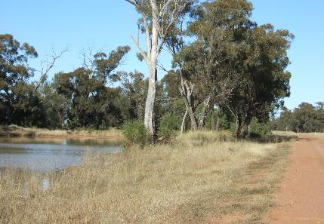
Preparing an REF
Step 3: Consider Existing Environment & Impact Assessment
3. Water Quality and Hydrology
Consider if the proposed works are within 40m of a waterway;
Which catchment is the proposed activity in, and where does the site drain to?
Is the site within flood prone land? Will the works intercept groundwater aquifers?
Council Roadside Reserves Project

Slide 26
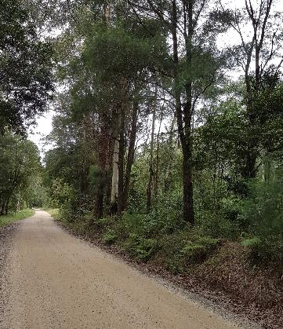
Preparing an REF
Step 3: Consider Existing Environment & Impact Assessment
4. Biodiversity
(i) Populate the following tabs in the REF Methodology Workbook:
Threatened Flora;
Threatened Fauna;
TECS
(ii) Consider:
The likelihood of each species to occur within the vicinity of the subject site;
The potential impact of the proposed activity on these species.
Council Roadside Reserves Project

Slide 27
Preparing an REF
The following is to be taken into account for the purposes of determining whether a proposed development or activity is likely to significantly affect threatened species or ecological communities, or their habitats:
(a) in the case of a threatened species, whether the proposed development or activity is likely to have an adverse effect on the life cycle of the species such that a viable local population of the species is likely to be placed at risk of extinction,
(b) in the case of an endangered ecological community or critically endangered ecological community, whether the proposed development or activity:
(i) is likely to have an adverse effect on the extent of the ecological community such that its local occurrence is likely to be placed at risk of extinction, or
(ii) is likely to substantially and adversely modify the composition of the ecological community such that its local occurrence is likely to be placed at risk of extinction,
(c) in relation to the habitat of a threatened species or ecological community:
(i) the extent to which habitat is likely to be removed or modified as a result of the proposed development or activity, and
(ii) whether an area of habitat is likely to become fragmented or isolated from other areas of habitat as a result of the proposed development or activity, and
(iii) the importance of the habitat to be removed, modified, fragmented or isolated to the long-term survival of the species or ecological community in the locality,
(d) whether the proposed development or activity is likely to have an adverse effect on any declared area of outstanding biodiversity value (either directly or indirectly),
(e) whether the proposed development or activity is or is part of a key threatening process or is likely to increase the impact of a key threatening process.
Step 3: Consider Existing Environment
& Impact Assessment
4. Biodiversity cont.
(iii) For Species that have the potential to be impacted by the proposed works, conduct an Assessment of Significance under s7.3 of the BC Act (5 part Test)
Council Roadside Reserves Project

Slide 28
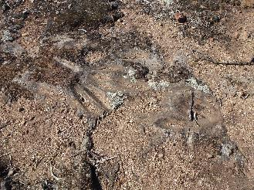
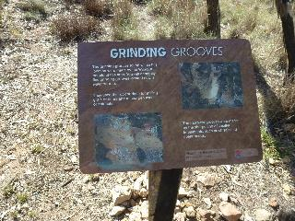
Preparing an REF
Step 3: Consider Existing Environment & Impact Assessment
5. Aboriginal Heritage
Consider if there are any Aboriginal objects or sites in the vicinity of the subject site;
Is the proposed activity a ‘low impact activity’
Is an AHIP required?
Council Roadside Reserves Project

Slide 29
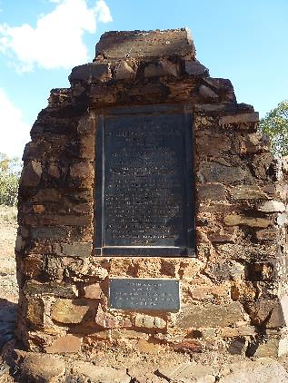
Preparing an REF
Step 3: Consider Existing Environment & Impact Assessment
6. Non-Aboriginal Heritage
Consider if there are any non-Aboriginal heritage sites in the vicinity of the subject site;
Will the proposed activity have any impact on these sites?
Council Roadside Reserves Project

Slide 30
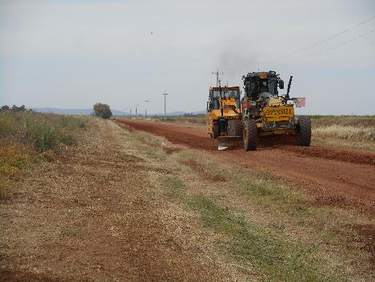
Preparing an REF
Step 3: Consider Existing Environment & Impact Assessment
7. Noise and vibration
What are the sources of noise/vibration from the proposed activity?
What are the proposed hours of operation?
Are there sensitive receivers nearby who need to be notified?
Council Roadside Reserves Project

Slide 31
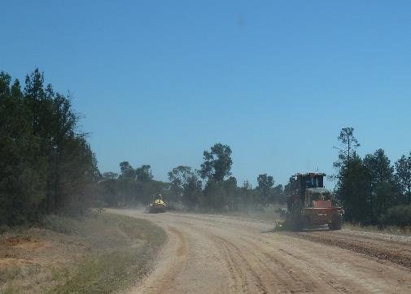
Preparing an REF
Step 3: Consider Existing Environment & Impact Assessment
8. Air quality
Identify sources of air and odour emissions of the proposed works;
Identify nearby sensitive receivers.
Council Roadside Reserves Project

Slide 32
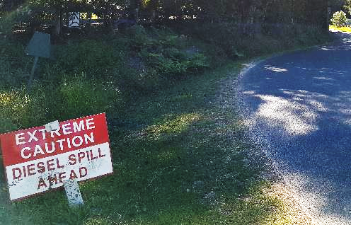
Preparing an REF
Step 3: Consider Existing Environment & Impact Assessment
9. Waste and chemical management
Identify sources of waste generated during the proposed activity.
What types and volumes of waste are anticipated?
Where and how will they be disposed?
Council Roadside Reserves Project

Slide 33
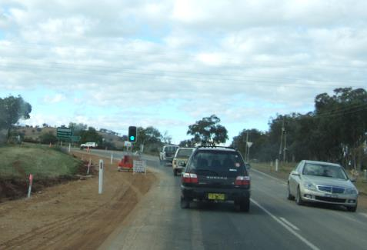
Preparing an REF
Step 3: Consider Existing Environment & Impact Assessment
10. Traffic
Will traffic and/or pedestrian access be affected by the proposed activity?
What will be the duration of any disturbance?
Consider who may need to be notified.
Council Roadside Reserves Project

Slide 34
Preparing an REF
Step 3: Consider Existing Environment & Impact Assessment
11. Visual Amenity/ Landscape
Will the proposed activity affect the visual amenity and/or landscape?
What will be the timeframe/duration of any impact?
Who will need to be notified?
Council Roadside Reserves Project

Slide 35
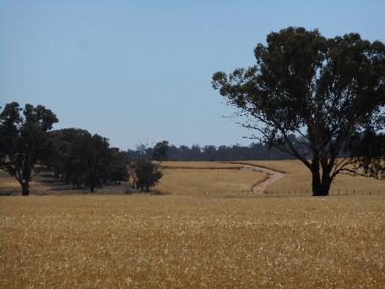
Preparing an REF
Step 3: Consider Existing Environment & Impact Assessment
12. Socio-Economic Factors
Will the proposed activity affect local residents or the wider local community?
Council Roadside Reserves Project

Slide 36
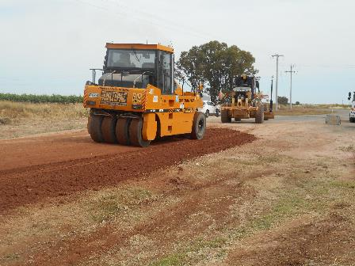
Preparing an REF
Step 3: Consider Existing Environment & Impact Assessment
13. Cumulative Impacts
Are there any other works happening in the vicinity of the proposed activity?
What will be the cumulative impact on the region?
Council Roadside Reserves Project

Slide 37
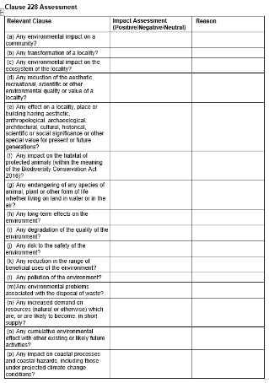
Preparing an REF
Step 3: Consider Existing Environment & Impact Assessment
14. Clause 228
Complete the table to satisfy requirements of s228 of the EP&A Regulation.
Council Roadside Reserves Project

Slide 38
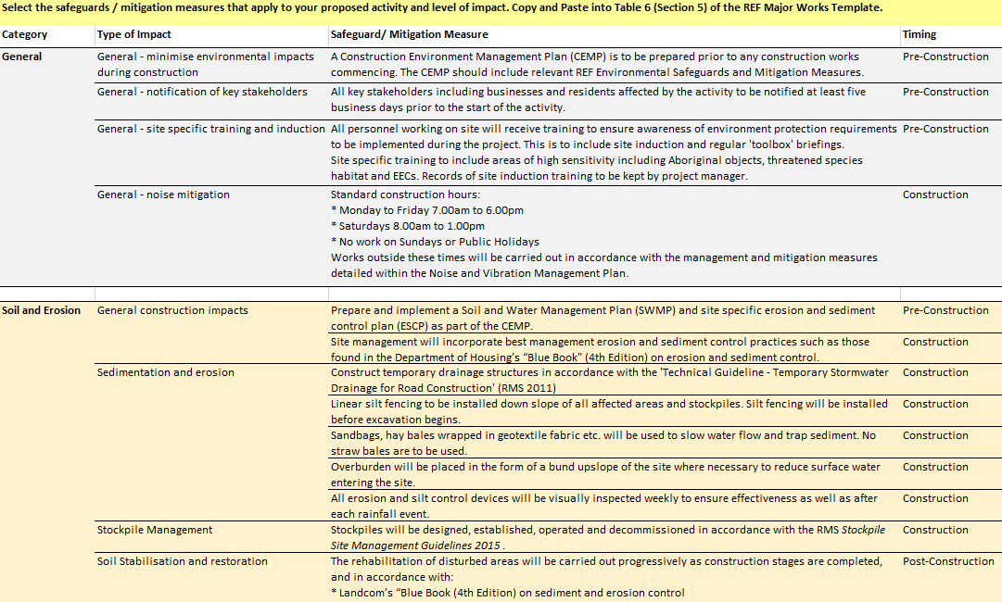
Preparing an REF
Step 4: Environmental Safeguards and
Mitigation Measures
Consider any standard environmental safeguards your Council implements for roadside projects;
The REF Workbook contains suggested mitigation measures for a range of potential impacts from roadside activities.
Council Roadside Reserves Project

Slide 39
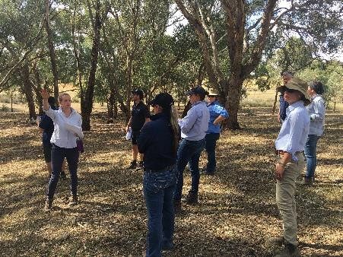
Preparing an REF
Step 5: Consultation
Consider which stakeholders need to be consulted;
Guided by ISEPP;
Consult with internal Council environmental officer.
Council Roadside Reserves Project

Slide 40
Preparing an REF
Step 6: Conclusion
Provide a brief summary of the findings of the REF;
Consider whether:
There is likely to be a significant impact on the environment (if so, an EIS is required);
There is likely to be a significant effect on threatened species, populations, ecological communities or their habitats (if so, an SIS is required);
The activity is in respect of land that is, or is part of, critical habitat (if so an SIS is required).
Council Roadside Reserves Project

Slide 41
Preparing an REF
Step 7: REF Determination
Declaration by the proponent that the information contained in the REF is neither false nor misleading;
Acknowledgement by the person who prepared the REF that all potential impacts of the proposed activity have been assessed to the fullest extent possible.
Council Roadside Reserves Project

Slide 42
This presentation was prepared by Dr Emma McIntyre of EMAP Consulting for local councils in NSW as part of the Local Government NSW (LGNSW) Council Roadside Reserve Project, September 2019.
Many of the photos used in this presentation were generously supplied by Dr Meredith Brainwood from Applied Ecology and CRR Grant Recipients.
Council
Roadside Reserves Project
This project has been assisted by the New South Wales Government through its Environmental Trust.

